Slide 1
Write the Rights!
SS.7.C.2.4 Evaluate rights contained in the Bill of Rights and other amendments to the Constitution.
Evaluating rights in the U.S. Constitution

Slide 2
As You Enter the Class…
Turn on your camera and mute your mic.
Type your name into the chat.
Go to the Bell Ringer tab and start working on the question for the day.

Slide 3
BELL RINGER
Which part of the 1st Amendment do you think is the MOST important, and why?

Slide 4
Role of the Constitution
Outline the structure and function of government
Protect the rights of the people

Slide 5
The Bill of Rights
Rights: guarantees or protections
Bill of Rights: The first 10 amendments to the US Constitution
Amendments are changes or additions to a document

Slide 6
HOW DID WE GET THE BILL OF RIGHTS?
Federalists vs. Anti-Federalists

Slide 7
Difference of Opinion
Federalists
Anti-Federalists
Were worried that the Constitution would bring tyranny
People should be protected from the power of government by having clearly outlined rights in a “Bill of Rights” in the Constitution
Wanted the Constitution to be approved
Believed the Constitution in its original form would protect the rights of the people

Slide 8
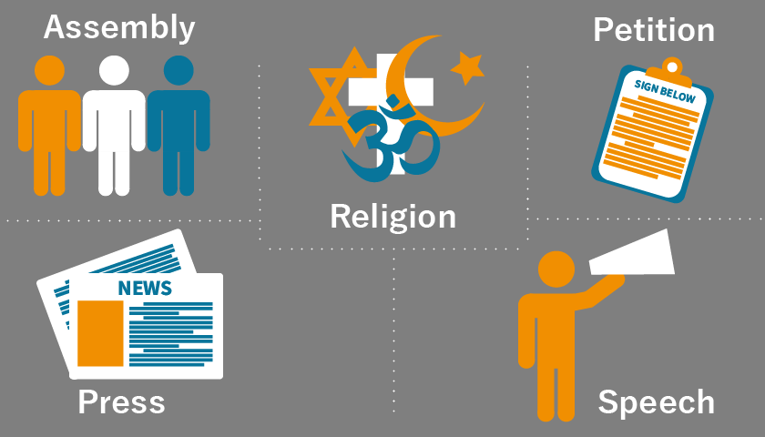
1st Amendment

Slide 9
Bill of Rights
Amendment | Rights/Guarantees
1st | Freedom of expression
2nd-3rd | Protection
4th-8th | Rights of the accused
9th-10th | Rights of citizens and the states

Slide 10
Assignment
Go to the Assignments tab and find the assignment called “Bill of Rights.”
Click on the PDF labeled “p. 110-116 (Bill of Rights).” We will be reading p. 114-116.
Click on the Word doc labeled “Bill of Rights” and fill out the chart with the meaning of each of the amendments.

